Slide 1
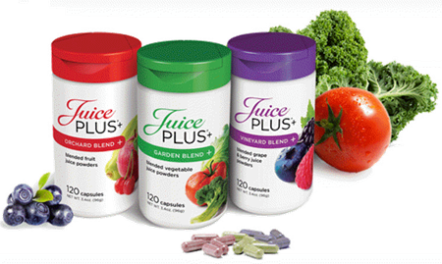
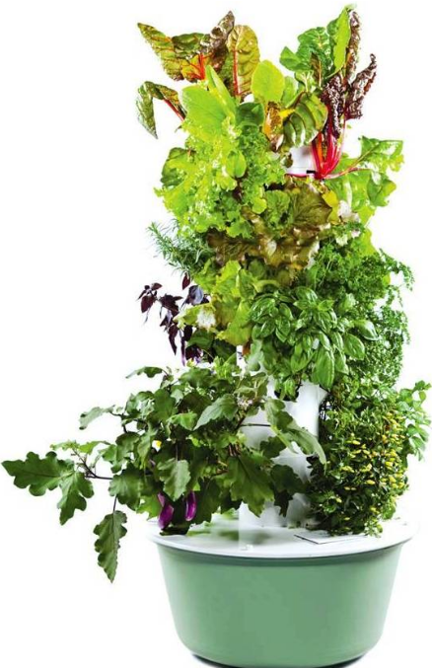
JUICE PLUS+® CAPSULES and GUMMIES
More than 30 Clinical Studies!
key antioxidants and phytonutrients are absorbed by the body.
reduces oxidative stress.
reduces biomarkers of systemic inflammation.
helps support a healthy immune system.
helps protect DNA.
supports cardiovascular wellness.
supports healthy skin.
supports healthy gums.
JUICE PLUS+® is Whole Food nutrition from 25 fruits, vegetables, berries & grains.
~Farm to Capsule~
Highest quality produce is grown. With the skin & seeds intact, a large grinder breaks pieces into small bits & breaks them down into a fine slurry. They’re dried and encapsulated.
Every batch is tested for the absence of chemicals, pesticides and herbicides! Food label.
Gluten Free! NSF! Non-GMO!
Healthier
Grow vegetables, fruits, & herbs at home.
Easier
Simplify growing with a vertical garden placed on your patio, rooftop, or balcony. No soil. No weeding.
Smarter
Invest in your health with an eco-friendly aeroponic garden that pays for itself.
Tammy Miceli RN 630-776-9243
www.tammy-miceli.juiceplus.com
GROW A VERTICAL TOWER GARDEN

