Slide 1
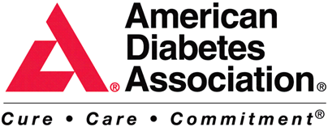
FACT
ALL SAY that the risk of heart disease, stroke and cancer is reduced by 50% or more by consuming 9 -13 servings of fruits, vegetables and grains every day.

Slide 2
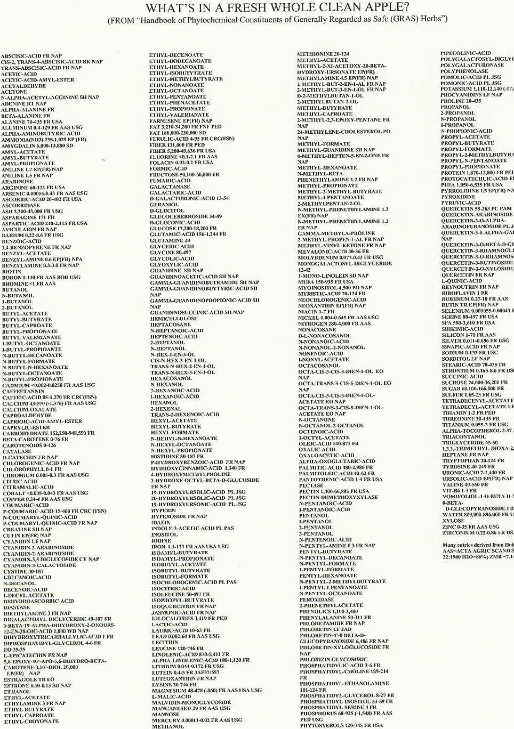
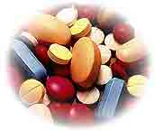
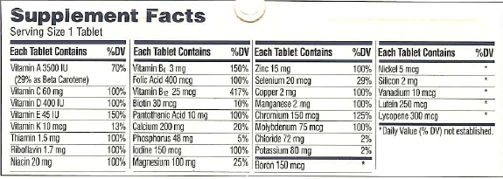
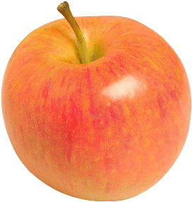
Whole Food vs. Vitamins!
The average multiple vitamin has 31 total
isolated nutrients.
An apple alone has over 10,000 phytonutrients.
Only 400 are listed here!
Notes:
So to compensate for a poor diet – Americans have always turned to vitamins. But science has discovered that we need to get our vitamins and other nutrients from whole food because of the “BALANCE.” Here’s what I mean…This page lists just 400 of the 10,000+ ingredients in an apple and we need ALL of these working together. That’s why health authorities recommend that we eat so many fruits and vegetables. We don’t have a vitamin deficiency in America, we have a fruit and vegetable deficiency.

Slide 3
Which would you rather drive to the store?

Slide 4
Smart and Easy
Notes:
How Juice Plus+ is made: “From Farm to Capsule”
We start with farm fresh nutrition – the highest quality fruits and vegetables we can find. We work wherever possible with mid-size family farms run by some of the best fruits and vegetable farmers in North America.
We carefully preserve our produce after harvest by locating our juicing and drying facilities as close to our farmers as possible. Where that’s not close enough, we utilize a process called Instant Quick Freezing (IQF) to ensure the freshness of each fruit and vegetable.
We use a proprietary juicing and drying process.
We juice the whole fruit or vegetable – including peels, leaves, and seeds – to capture the greatest amount of nutrition.
4) We produce Juice Plus+ at state-of-the-art facilities that meet or exceed highest food industry standards.
5) Our products and manufacturing facilities are inspected and certified by NSF, the not-for-profit public health and safety company.

