Slide 1
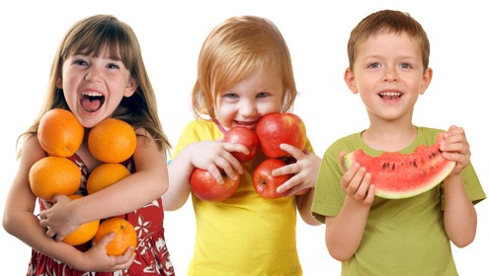
Inspiring Healthy Living

Slide 2
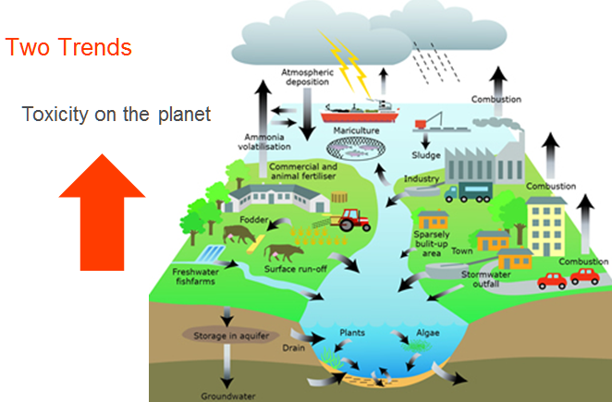

Slide 4
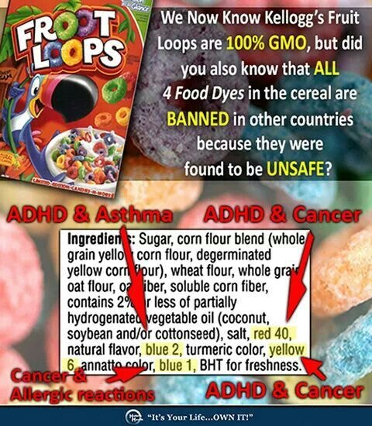
Food Dye

Slide 5
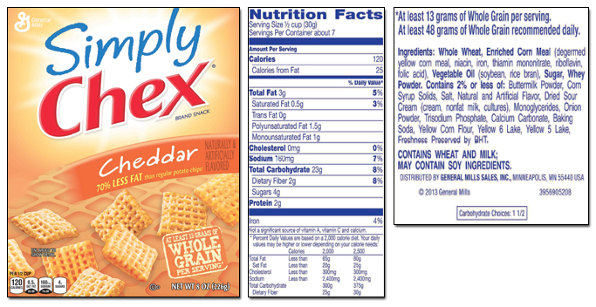
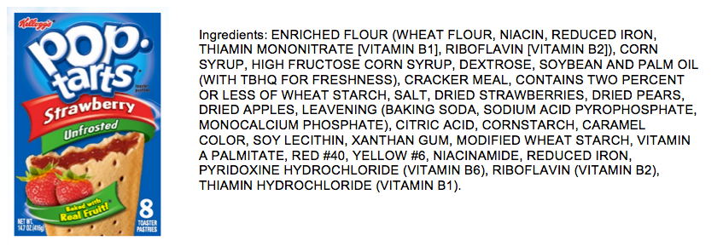
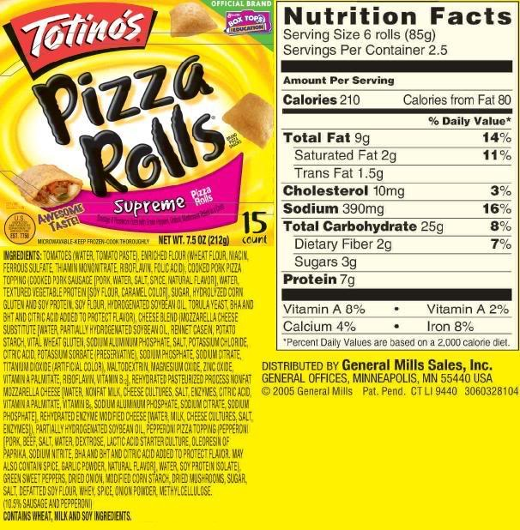
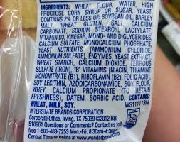
Fake food!
Try the 5 ingredient rule!

Slide 7
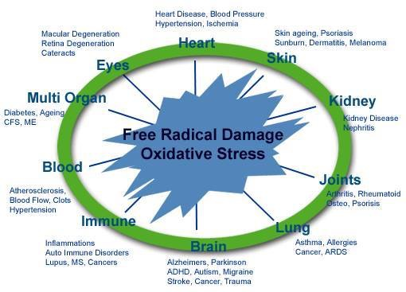

Slide 8
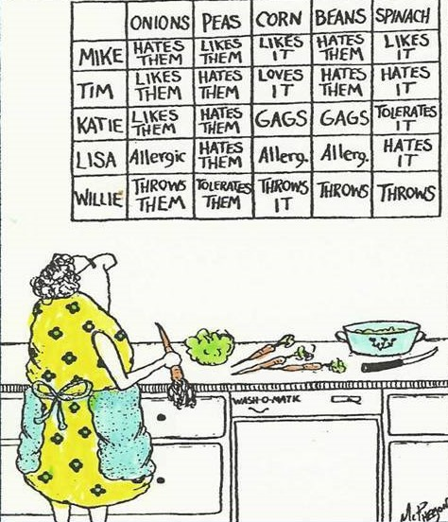
What is your biggest challenge in getting your family to eat fruits and vegetables?

Slide 9
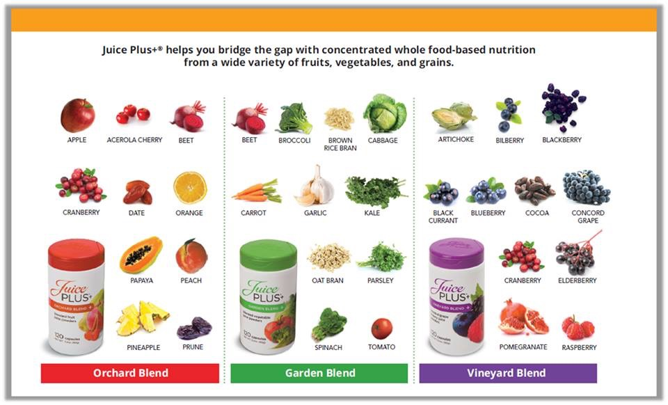
Bridge the gap with

Slide 10
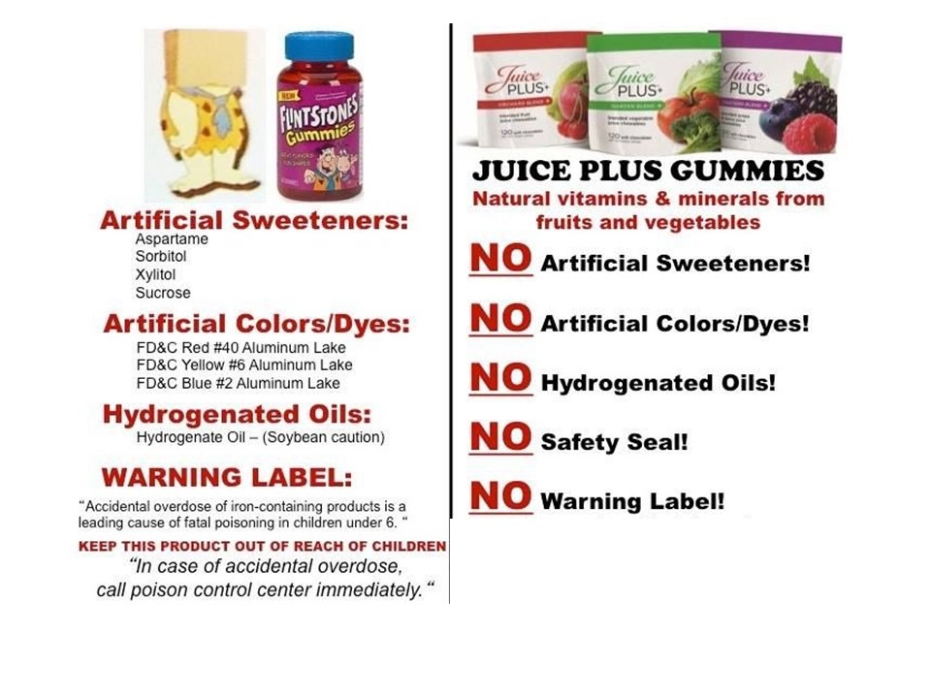
What about vitamins?

Slide 11
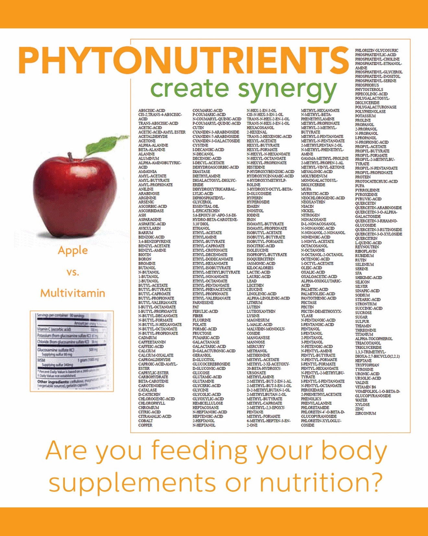
There are THOUSANDS of
phytonutrients
present in every apple!

Slide 12
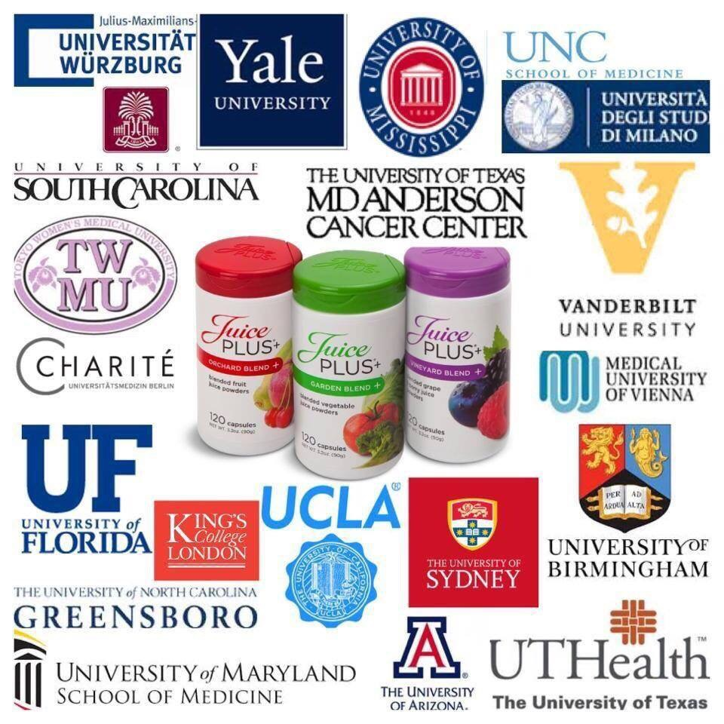
a
Over 30 published studies completed with 4 more underway!

Slide 13
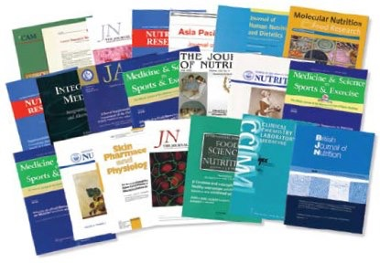
is clinically proven to:
Deliver key antioxidants and phytonutrients that are absorbed
by the body (it is bioavailable)
Reduce oxidative stress
Reduce key biomarkers of systemic inflammation
Support a healthy immune system
Help protect DNA
Support cardiovascular wellness
Support healthy skin
Support healthy gums

Slide 14
COMPLETE
13 grams of protein
8 grams of fiber
Low glycemic
Gluten free
Dairy free
Vegan

Slide 15
a

Slide 16
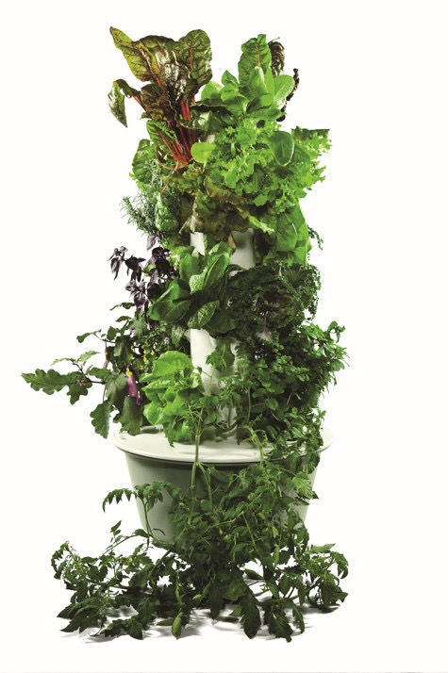
10 Reasons to start a
Costs $1.50 a day for 1 year and then it’s yours for 10-20 years
Made with food grade plastic (won’t leach chemicals into produce
Has a double UV protected coating (will last in the sunshine)
Uses 10% of the water of a conventional garden
Includes all of the tools and supplies you need
Fewer ground pest problems
Grow a garden in 30% less time than a traditional garden
Uses no harmful fertilizers, pesticides, or herbicides
No weeding
Vine ripened produce is proven more nutritious

Slide 17
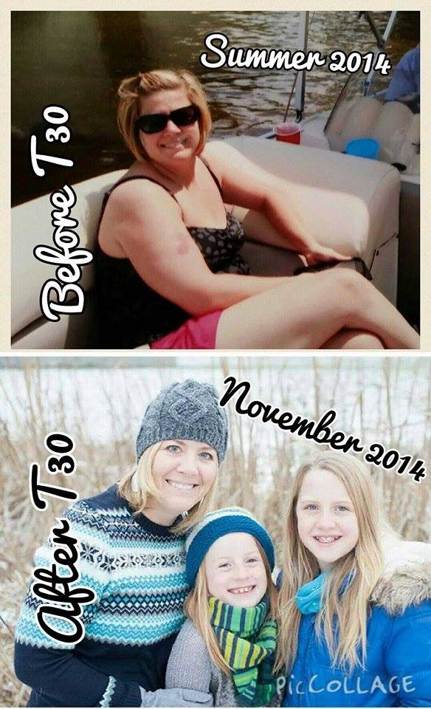
Transform 30

Slide 18
Cut out fake food
Move more
Reduce caffeine
Reduce sugar
Eliminate
artificial
sweetener
Cut out
food dye
Get more sleep
Stop eating
fast food
Follow the 5
ingredient rule
Eat more green food
Take the stairs

Slide 19
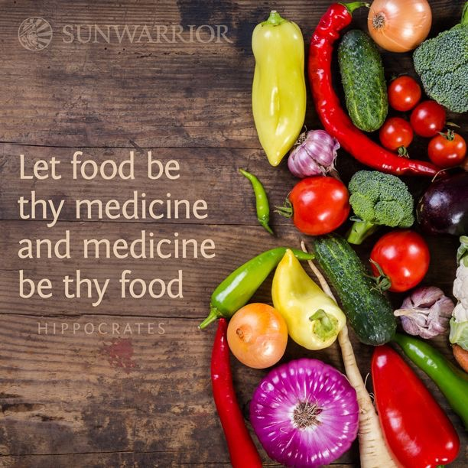
Everyday is another chance
to change your life.
I hope you were inspired!

