Slide 1
Did you know?:
Tomato: 1 ~ 4
Carrot: 1 ~ 7
Broccoli 1 ~ 9
1953 ~ 2008
As of 1/1/05 the recommendation is 9-13 servings!

Slide 3
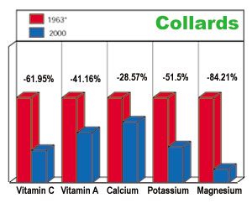
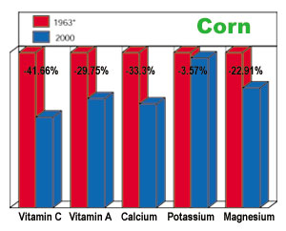
Change in nutrient content of Collards and Corn 1963 - 2000
Source: USDA Nutrient Databases
Notes:
To illustrate this point, here are graphs of two vegetables, collards and corn that compare the nutrient content of produce grown in 1963 to produce grown in 2000.

